Slide 1

BERT HS Code Classification for Dec 2024 PANYNJ Import Data

Slide 2
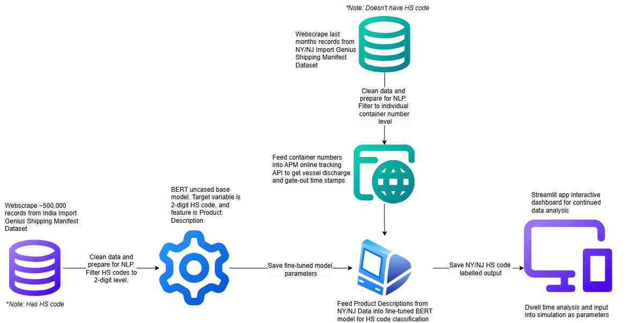
BERT HS-code classification:
Pipeline
Run once
Continuously update with new data

Slide 3
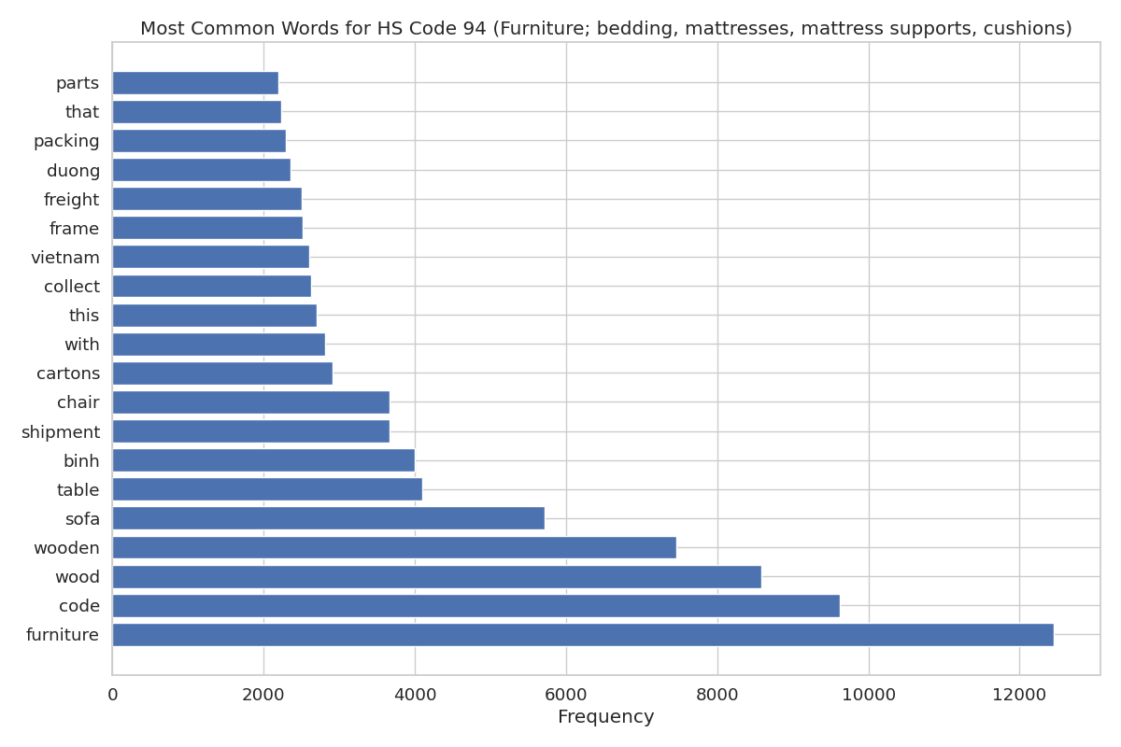
Most Common Words for HS Code 94 (Furniture, bedding, and lighting)

Slide 4
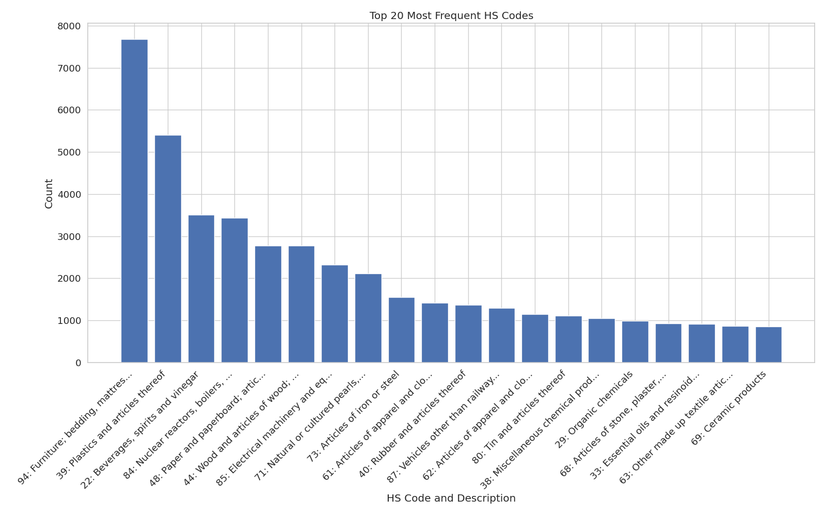
Top 20 Most Frequent HS Codes
Sample of 50,000 NY imports (APM terminal only) for December 2024

Slide 5
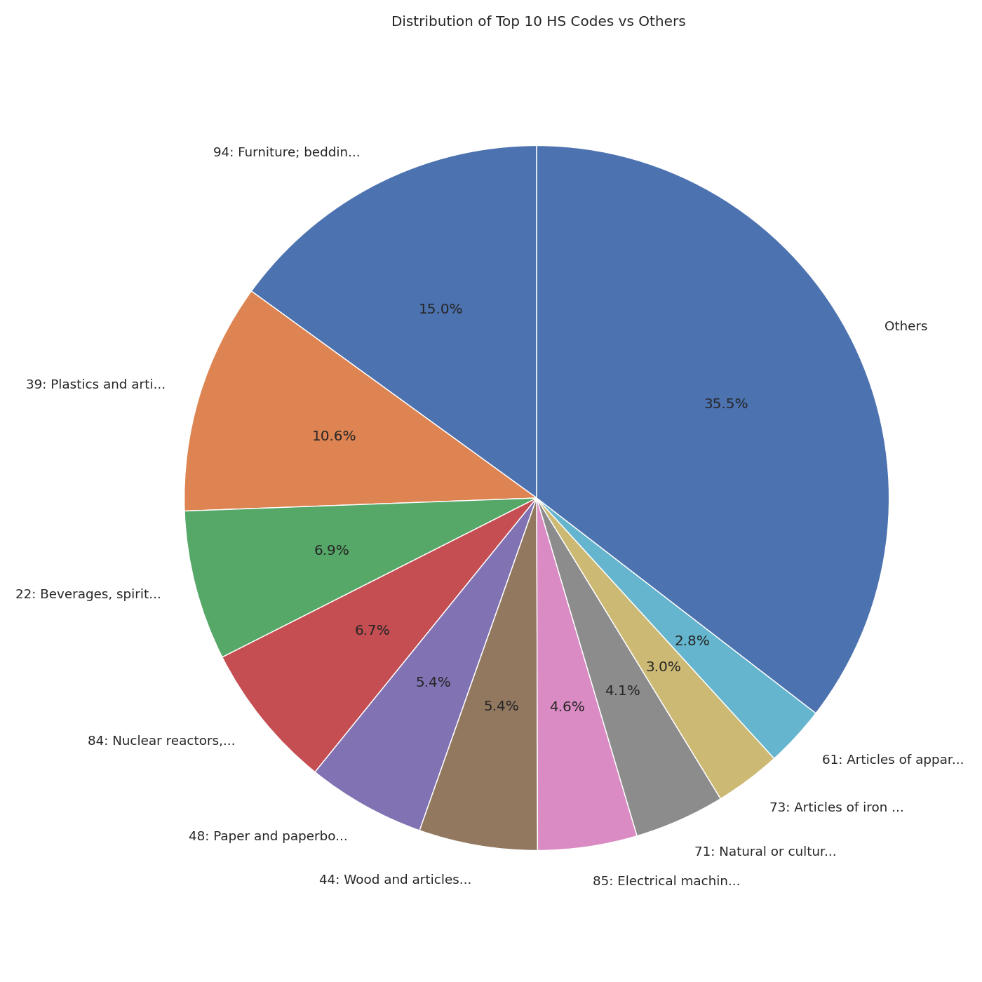
Pie Chart Breakdown

Slide 6
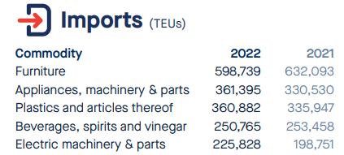
2021/2022 Port-at-a-Glance (from PANYNJ)

Slide 7
Comparison: Our Analysis vs. Port Values
Rank | Our Dataset (HS Codes) | Port Authority (TEUs - 2021)
1 | Furniture, bedding, and lighting (HS 94) | Furniture – 632,093 TEUs
2 | Plastics and articles thereof (HS 39) | Plastics and articles thereof – 335,947 TEUs
3 | Beverages, spirits, and vinegar (HS 22) | Appliances, machinery & parts – 330,530 TEUs
4 | Machinery and mechanical appliances (HS 84) | Beverages, spirits, and vinegar – 253,458 TEUs
5 | Paper and paperboard products (HS 48) | Electric machinery & parts – 198,751 TEUs

Slide 8
Initial Dwell Time Analysis
Integrating HS code-classified containers numbers with APM terminal tracking timestamps

Slide 9
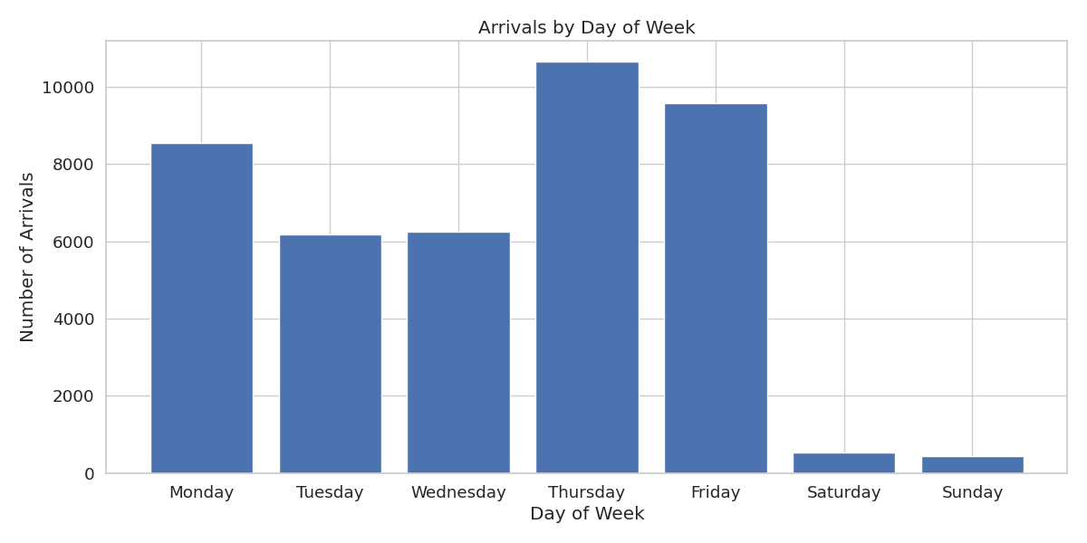
Container Arrival Count by Day of Week

Slide 10
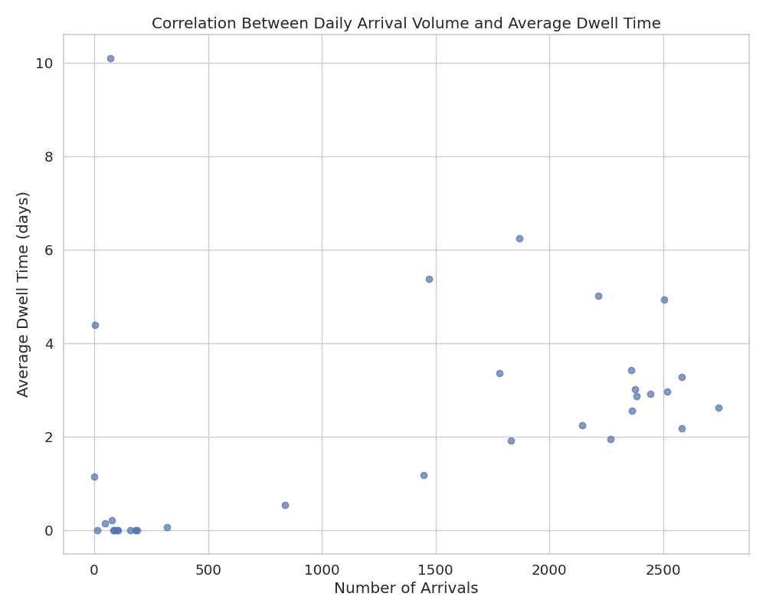
Impact of Megaships? Correlation Between Daily Arrival Volume and Average Dwell Time: 0.4129

Slide 11
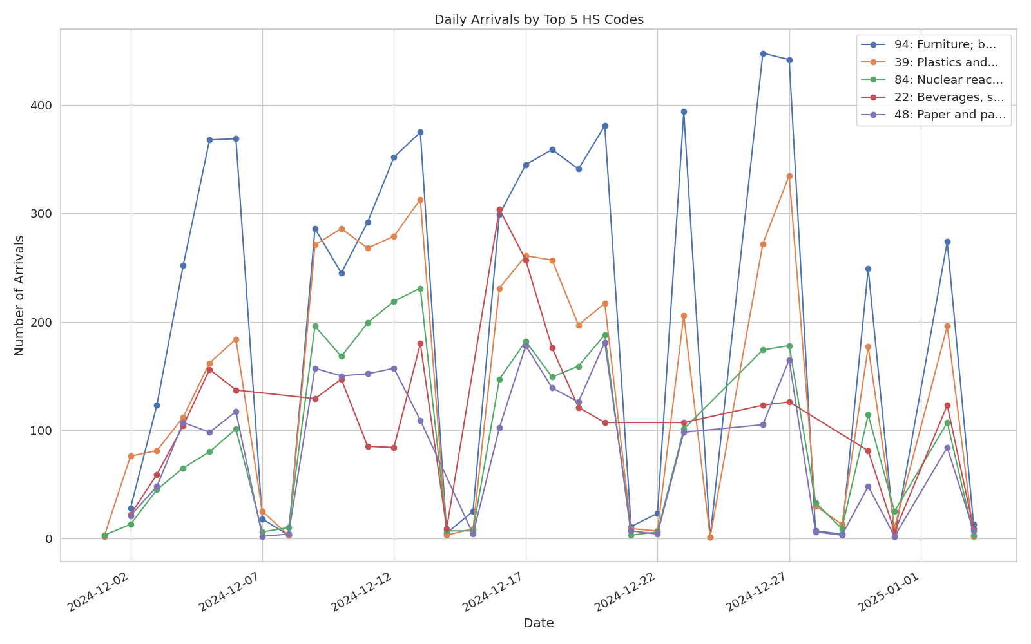
Daily Arrivals by HS code

Slide 12
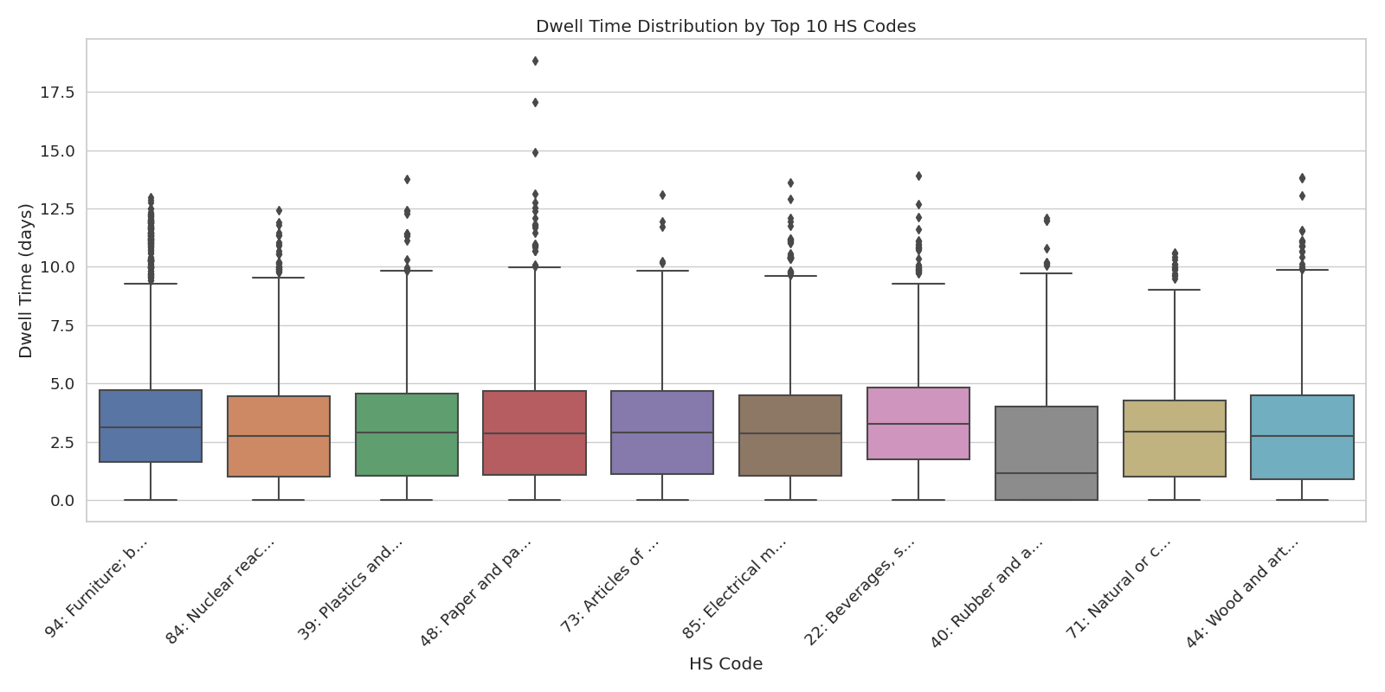

Slide 13
